Slide 1








Song recommender project

Slide 2


Problem!!
Have you ever been browsing through Spotify when suddenly the next song that comes on completely disrupts the mood?
Ever struggled to create the perfect playlist for your next dinner party discussing cryptocurrencies?
We know, we’ve all been there

Slide 3





Be like Dave
This is Dave then
This is Dave now
Nobody liked Dave
People think he’s cool

Slide 4




Meet
Your unique song recommender.

Slide 5




Key Features
Input song
Algorithm check
Add to playlist
Analyse
Recommend
Enjoy
A revolutionary engine that analyses multiple features of your favorite song to suggest similar tracks
Effortlessly create playlists that maintain a consistent vibe by leveraging our advanced AI-driven recommendations
Import the suggested songs directly into a playlist for a seamless listening experience

Slide 6




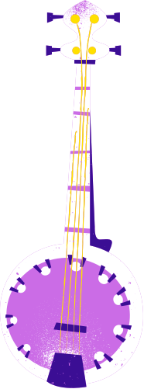




Testimonials
My Mother
“I can now listen to more than just one song”
Denise (Bank CEO)
“I can discreetly groove in the toilets”
Shaniqua
(customer service rep)
Dave (remember Dave?)
“Clients no longer wait listening to jingles”
“I now have friends”
Mary(Dave’s mother)
Heather (radio host)
“House parties have never been better”
“I no longer have to lose time googling for songs”
“House parties have never been better”

Slide 7





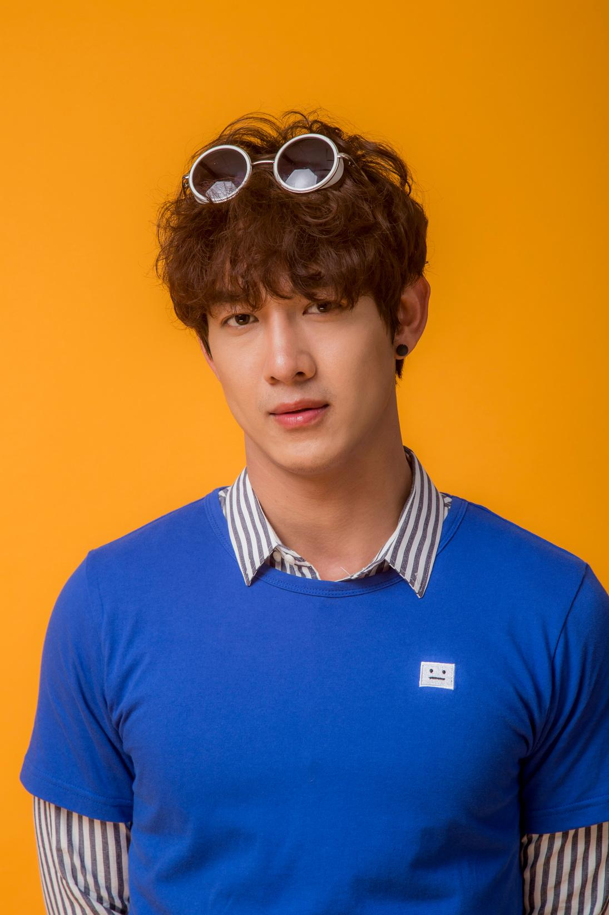
MEET THE TEAM
Pablo
Jomana
Ralph

Slide 8









DEMO
Search for your song
Enter song…
Analysing…
Recommendations
Rammstein - Feuer frei!
Marilyn Manson - Beauty
Ministry - N.W.O
…
Add Playlist to Spotify
https://hitmatch.herokuapp.com/

